Slide 1
Comprehensive Digital Marketing
Project Work

Slide 2
Student Declaration
I KOSURI JAGADEESWARI a student A.M.A.L COLLEGE program Reg No.120120103077 of the Department of Commerce college do hereby that i have completed the mandatory internship from 29-05-2023 to 04-08-2023 in DIGITAL MARKETING [name the intern organization under the faculty guideship of SMART BRIDGE, [name of the faculty guide],department of COMMERCE A.M.A.L ANAKAPALLI [name of the college]
K.JAGADEESWARI
[signature and date]

Slide 3
ACKNOWLEDGMENT
I would like express my sincere thanks to MR/MRS YADALA NAIDU [mentor name],for his /her valuable guidance and support in completing my project I wish to express my gratitude to the digital Marketing for giving me such a good ideas by granting permission to do a long team internship HI would like to express my gratitude towards our long team internship project coordinator T.NIRANJAN KUMAR for his encouragement and problem solving during the project I extend my gratefulness to our correspondent sir MR.DADI SRINIVAS RAO and director K.S.N MANGA RAJU sir for their support and heartfelt completing the project
i would also like to express my gratitude to words our principal DR.G.JAYABABU for giving me this great opportunity in do a project on LAKME .without their support and suggestions this project would not have been completed
K.JAGADEESWARI
(SIGUNATURE)

Slide 4
Team members
TEAM LEADER : KOSURI JAGADEESWARI
TEAM MEMBER 1: YALAMANCHILI APPALARAJU
TEAM MEMBER 2: YARRAMSETTI HEMANTH
TEAM MEMBER 3: YEDDU SAI

Slide 5
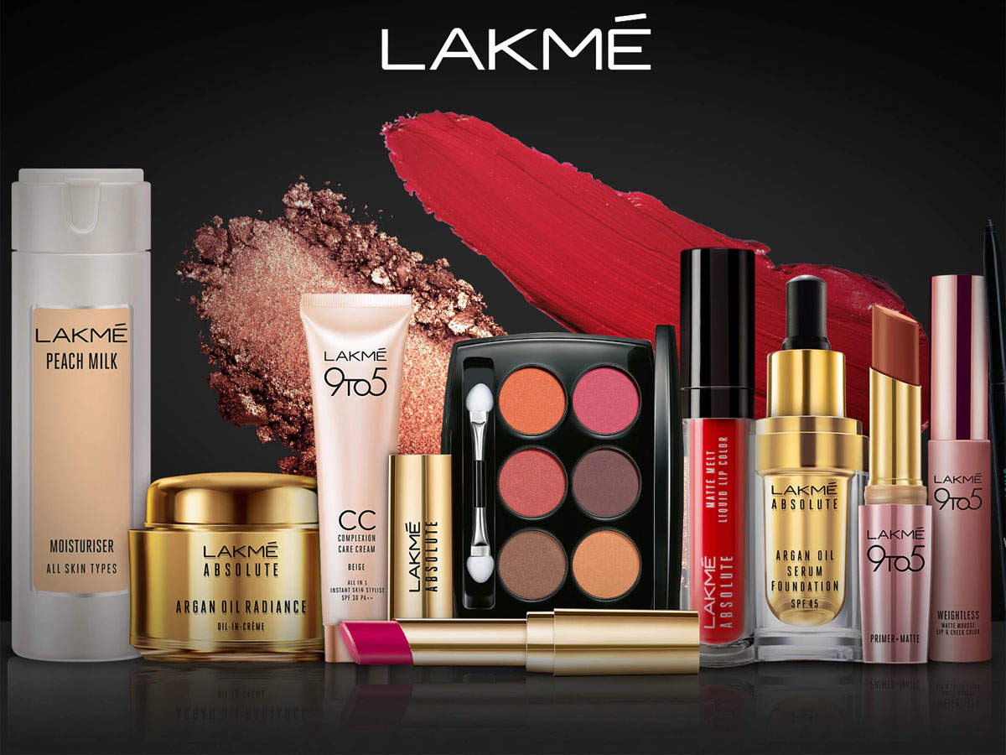

Slide 6
OVERVIEW OF ORGANIZATION
Lakme is an Indian cosmetics brand, owned by Hindustan Unilever. It was named after the French opera Lakme, which itself is the French word for goddess Lakshmi who is renowned for her beauty. It was started in 1952 as a 100% subsidiary of Tata Oil Mills, famously after Prime Minister Jawaharlal Nehru was concerned that Indian women were spending precious foreign exchange on beauty products and persuaded JRD Tata to manufacture them in India. Initially it was called Lakshmi beauty products later rebranded it to Lakmé and [1] Simone Tata joined the company as director and went on to become the chairperson.[2] In 1998, Tatas sold their stake in Lakmé to Hindustan Unilever[3] for ₹200 crore
Lakmé mainly sells colored cosmetics products such as lipsticks, eyeliners and skincare cream. In December 2018, it launched its e-commerce platform.[5][6] As of 2021, Lakmé also runs 485 beauty salons under Lakmé Lever.[7] The company Combining international cosmetic technology with an in-depth understanding of the Indian woman's needs, Lakmé also offers its consumers a comprehensive beauty experience through its products that are ideal for a variety of Indian skin tones..
is the title sponsor for Lakme Fashion Week (LFW), a bi-annual fashion week which takes place mumbai

Slide 7
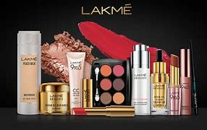
Part 1: Brand study, Competitor Analysis & Buyer’s/Audience’s Persona
Research Brand identity:.
Mission / values:
“An Ally to the classic Indian woman Lakme inspire her to express the unique beauty and sensuality within enabling her to realize the potency of her beauty”.

Slide 8
KEY FACTS :
Lakme was the country’s first cosmetic brand to introduce make up to Indian Women and takes pride in being the expert on Indian beauty for over 50 years.
It is complete beauty brand spanning colour cosmetics and skincare and extending a beauty services through the network of Lakme beauty Salons.
It’s bond with beauty and fashion is manifested through the Lakme fashion week, which is the largest known fashion event ever in India.

Slide 9
USP : Lakme brings expert products and services that are borne out of true understanding. Lakme was the first major beauty brand in India with a legacy of over 60 years. Has a footprint of over 1200 assisted saves outline with beauty advisors in the country. Has a strong market share across India. Lakme started its new business in the beauty industry by setting up Lakme beauty salons all over India. Lakme brand boasts over 300 products, used in professional hair salons in over 70 countries around the world.

Slide 10
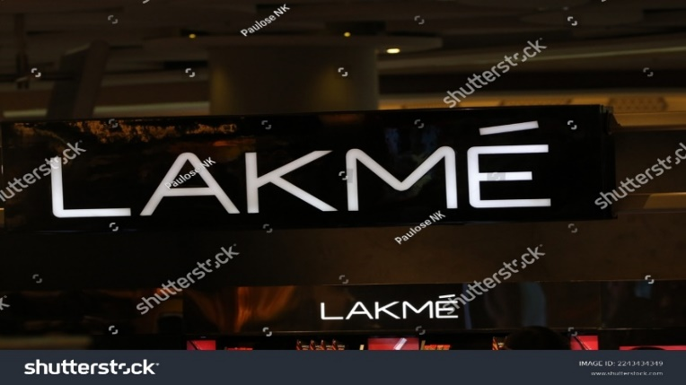
Brand colour : Baby pink, light cream colour and also red logo:
Tagline : A whole new world, a whole new look.

Slide 11
Part 1: Brand study, Competitor Analysis & Buyer’s/Audience’s Persona
.
Competitor 1: L'Oréal
USP: L’Oréal has operations in over 130 countries and over 4o manufacturing plants
1. Continuing research and innovation in the interest of beauty which assures that the L’Oreal Cosmetics offers the best to their consumers.
2. L'Oréal is a leader in the growing cosmetics industry despite the competition in the market
3. High-end advertising which adapts to the culture of target audience
Competitor 2: MAC
USP: 1. Founded in 1985 in Toronto Canada
2. Available over 200 locations in 15 countries with 2500 employees
3. Company owned and operated stores
4. Socially responsible image

Slide 12
Competitor 3: Maybelline
USP:
1. Maybelline has the top research and development teams and resources through their parent company L’Oreal
2. Maybelline has a coveted image of being hip, intelligent, stylish and charming which is positioned well to target young women
3. The brand has a strong market penetration and brand loyalty globally
4. The brand has competitive prices due to an effective cost of production

Slide 13
Part 1: Brand study, Competitor Analysis & Buyer’s/Audience’s Persona
Buyer's/Audience's Persona:
Demographic Information:
Brand Name : Lakme
Mostly used by : Women(59.32%)
3. Age range : 18 – 24(38.48%)
4. Marital status : Mostly Unmarried
5. Education : 10+2 and Under Graduates
6. Occupation : Students and young professionals
7. Income : 15,000 - 25,000
8. Location : Urban and semi-urban areas
9. Nationality : Indian(86.85%)
10.Religion : Mostly Hindus

Slide 14
Psychographic Information:
Social Class : Upper Middle class and Rich class
Behaviours : Often buys beauty products and are interested in maintaining their beauty
Interests : Most interested in buying women cosmetics
Habits : Online shopping, searching about beauty tips
5. Lifestyle : Want to lead a healthy lifestyle

Slide 15
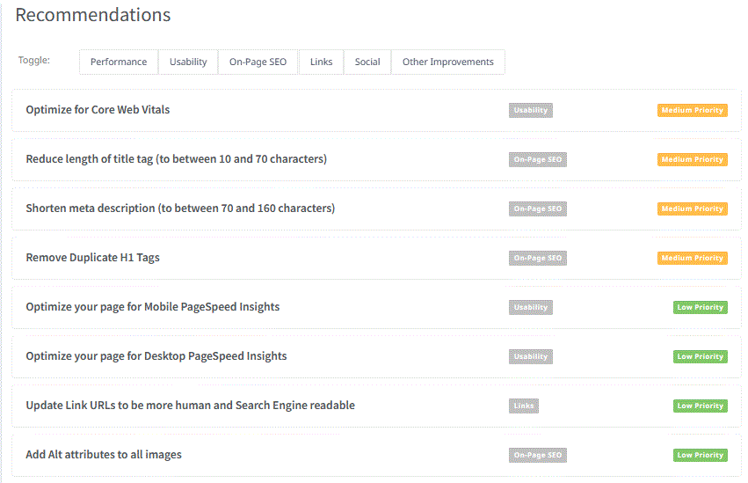
Part 2: SEO & Keyword Research
SEO Audit:
An SEO audit is a comprehensive evaluation of a website's search engine optimization (SEO) performance and overall health. The main purpose of an SEO audit is to identify areas of improvement and uncover issues that may be hindering the website's ability to rank well in search engine results. The SEO audit for lakme is as follows:

Slide 16
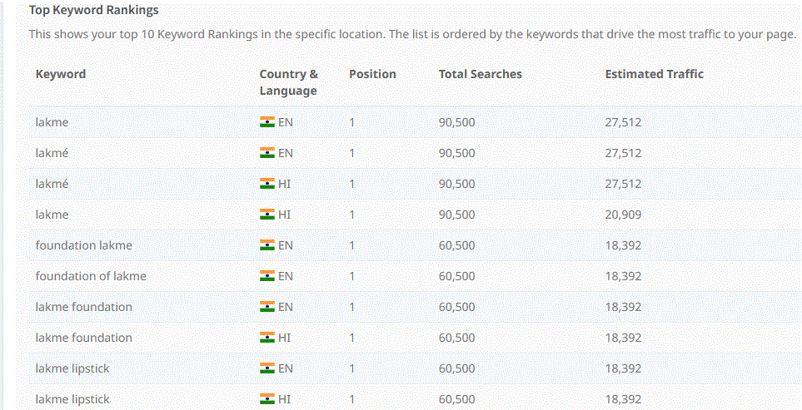
Rankings of keywords:
Keyword rankings refer to the positions that specific keywords or key phrases hold in the search engine results pages (serps) when users search for those terms. the keyword rankings for Lakme are as follows:

Slide 17
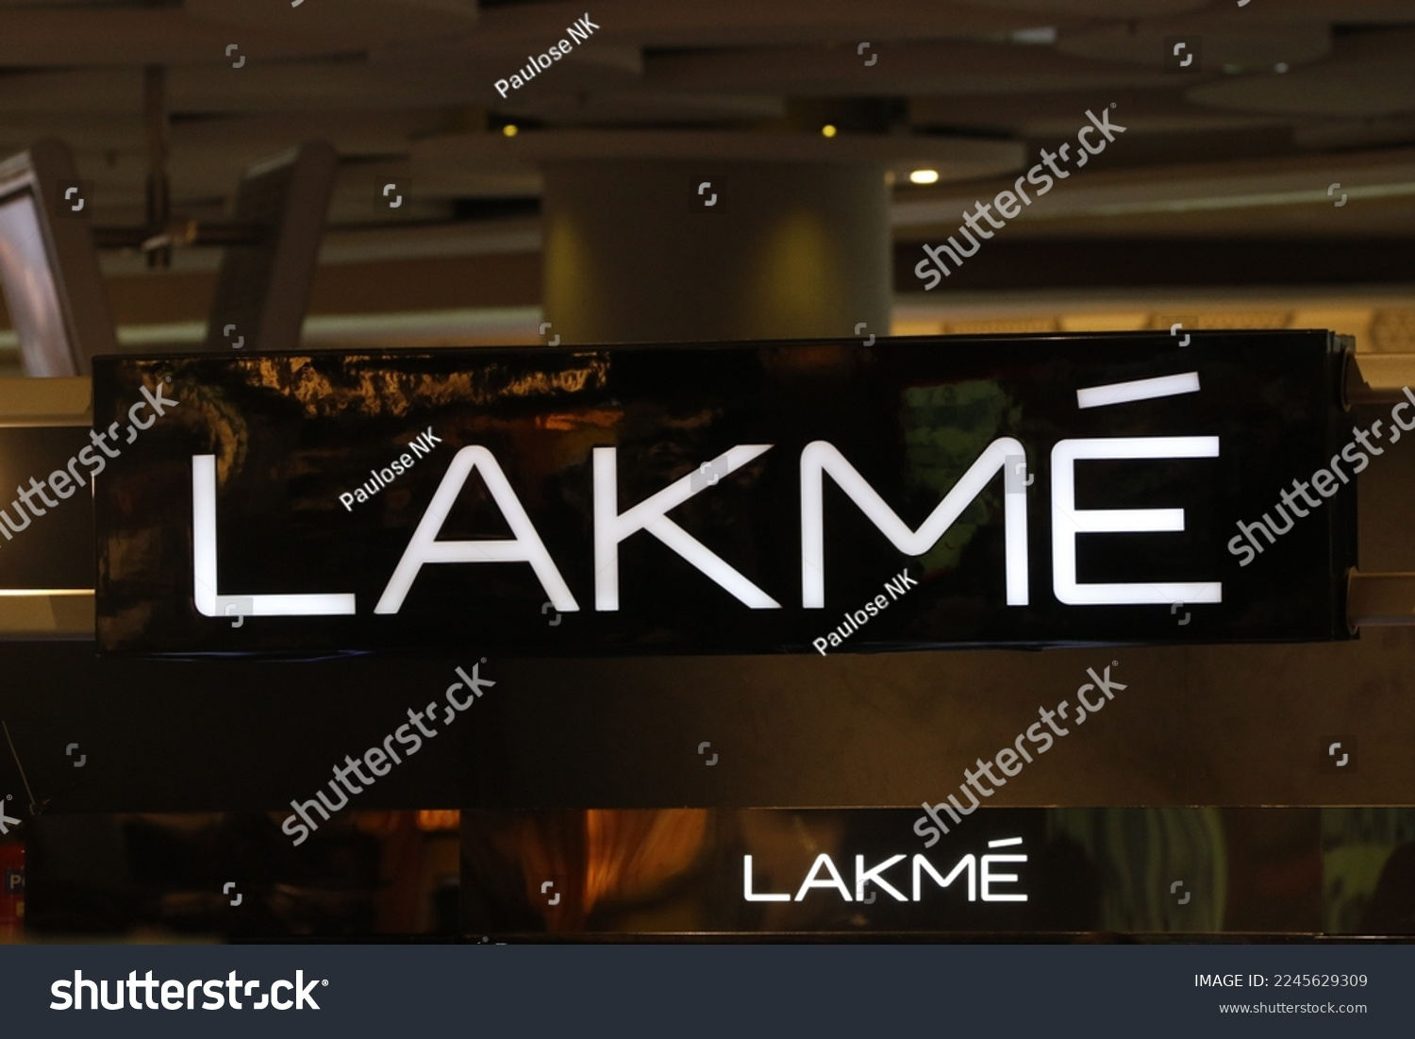
We have created the screen recording of SEO Audit of Lakme and the link is provided below:
https://drive.google.com/file/d/11hMZA7oik-IcR1nJNAw_CV9cwk1Y2ZyT/view?usp=sharing

Slide 18
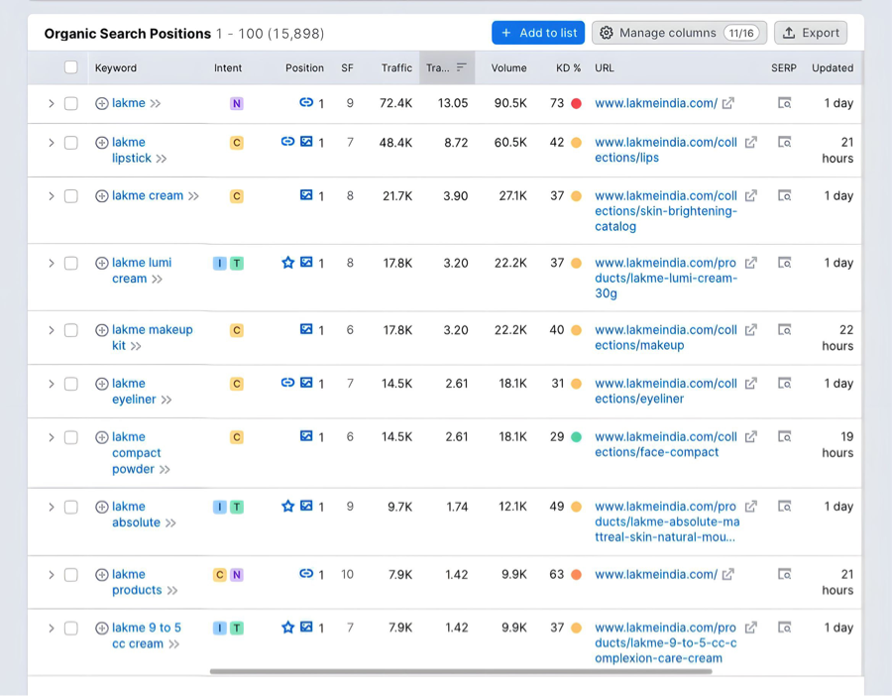
Part 2: SEO & Keyword Research
Keyword Research:

Slide 19
We have conducted a keyword research of our project Lakme in google keyword planner.
Google keyword planner conducted a survey and listed some keywords and the screenshot is provided above
It displayed Lakme as a top keyword. And 2nd place was captured by Lakme lipstick and Lakme cream
It’s essential to conduct compressive keyword research tools like google keyword planner or other SEO tools to identify the most relevant and high traffic keywords for the specific purpose of your content or marketing strategy
Additionally, you can explore long-tail keywords related to lakme to target niche audiences and improve search engine rankings

Slide 20
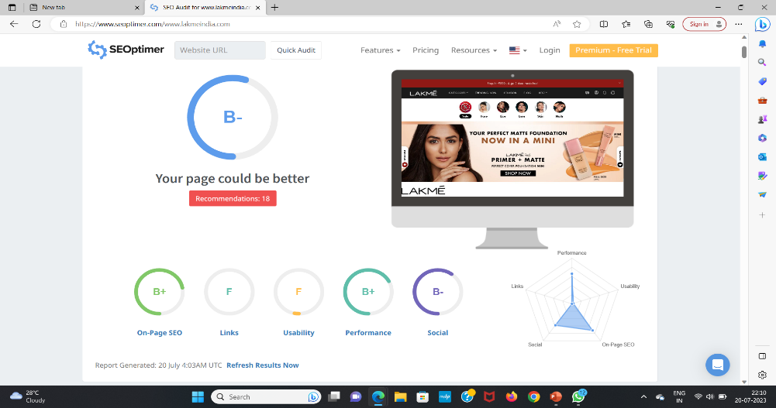
Part 2: SEO & Keyword Research
On page Optimization: On-page optimization, also known as on-page SEO (Search Engine Optimization), refers to the process of optimizing various elements on a website's individual pages to improve its visibility and ranking in search engine results. The primary goal of on-page optimization is to make the webpage more appealing and relevant to both users and search engines. The on-page optimization of Lakme is as follows

Slide 21
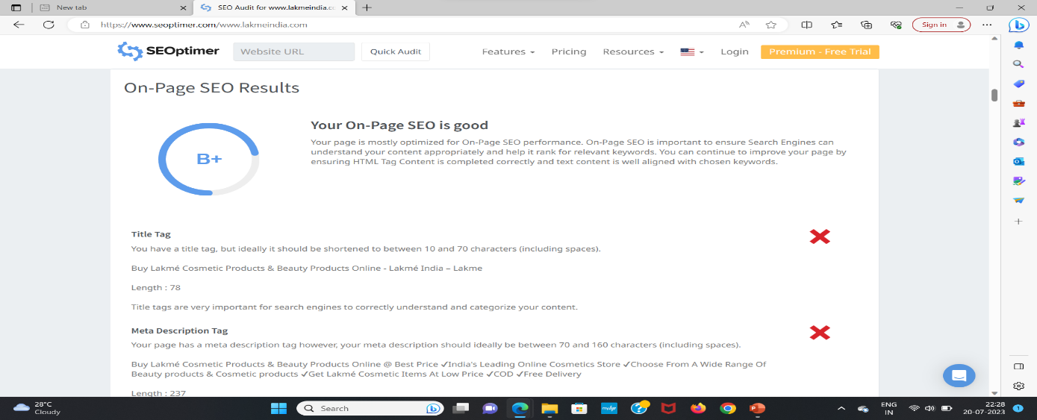
Above screenshot tells us that the title tag and meta description tag are not proper.
It suggests us that the title tag should be of length of minimum 10 characters to a maximum length of 70. But title tag is of 78 characters.
Apart of title tag meta description tag also can have a minimum length of 70 characters to a maximum length of 160 but www.lakmeindia.com has a character length of 237. In order to make the page or website better we have to change the character length to the character limit so that the page can be top in search rankings.

Slide 22
Part 3: Content Ideas and Marketing Strategies
Content Idea Generation & Strategy:
Date | Content Theme | Content Format | Platform | Strategy & Aim
17-07-2023 | About Lakme | Video | Facebook | To market Lakme products worldwide
18-07-2023 | Lakme Lipsticks | Blog Post | Instagram | To market Lakme famous Lipsticks
19-07-2023 | Lakme Success Story | Video | Facebook | To advertise the legacy of Lakme
20-07-2023 | Lakme Skin Care | Post | Instagram | To aware people about tremendous skin care
21-07-2023 | Behind Lakme | Video | Facebook | To show the hardwork of staff in Lakme
22-07-2023 | Lakme Quiz | Interactive Quiz | Instagram | Engage audience with interactive quiz
23-07-2023 | Struggles of Lakme | Video | Facebook | To show the struggles faced by Lakme organization

Slide 23
Part 3: Content Ideas and Marketing Strategies
Challenges:
Content Saturation: With the abundance of content available online, breaking through the noise and capturing the audience's attention becomes increasingly challenging. Creating unique, valuable, and engaging content is vital to stand out.
Audience Segmentation: Understanding and catering to diverse audience segments with different interests, preferences, and behaviors can be demanding. Marketers must develop content strategies that resonate with specific target groups.
Content Relevance: Ensuring that content remains relevant to the audience over time is essential. Content can quickly become outdated or lose its impact if not regularly updated or adapted to current trends.

Slide 24
4. Intense competition: The beauty and cosmetics industry is highly competitive, with numerous brands vying for the attention of consumers. Lakme faces stiff competition from both domestic and international beauty brands, making it crucial for them to continuously innovate and stay ahead of the game. 5. Market saturation: The market might be saturated with various beauty products and brands, making it challenging for Lakmé to create a unique identity and stand out from the competition. 6. Changing consumer preferences: Consumer preferences in the beauty industry can change rapidly, influenced by trends, social media, and influencers. Lakme needs to keep a pulse on these trends and adapt its marketing strategies accordingly. 7. Pricing strategy: Setting the right price point for products is essential. Lakme needs to strike a balance between affordability and maintaining a perception of high-quality products.

Slide 25
Part 4: Content Creation and Curation (Post creations, Designs/Video Editing, Ad Campaigns over Social Media and Email Ideation and Creation)
Post Creation:
Format 1:
We have created a blog article on Lakme popular lipsticks with the title named
Lakme Lipsticks Unleashed: Must-Have Shades and Formulas. We have gathered the
Information regarding Lakme lipsticks from internet and created a blog article and
Published the information on 21/07/2023 we have posting the link below
URL:https://saketh1678.blogspot.com/2023/07/lakme-lipsticks-unleashed-must-have.html

Slide 26
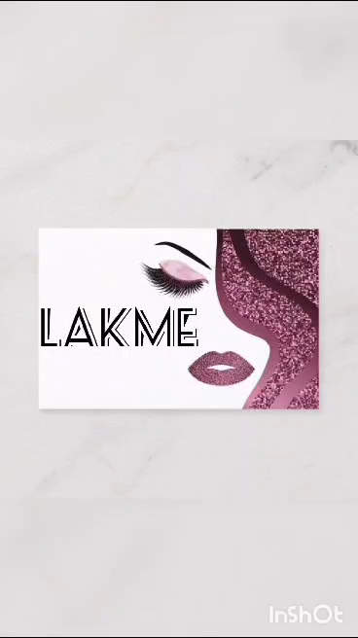
Format 2 : We have created a informative video about Lakme products. We have created the video on 21/07/2023. We are posting the video below:

Slide 27
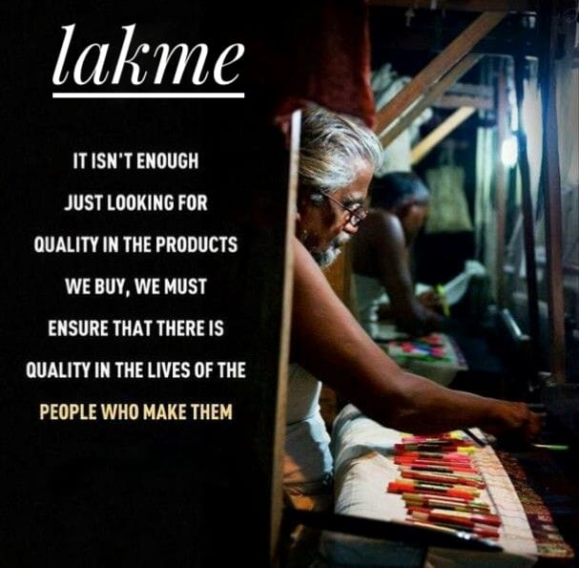
Format 3 : We have created an informative meme on Lakme on 21/07/2023

Slide 28
Part 4: Content creation and curation (post creations, Designs/Video Editing, Ad Campaigns over Social media and Email Ideation and Creation)
Instagram story:
We have created three Instagram stories on Lakme and screenshots and those are provided below:

Slide 29
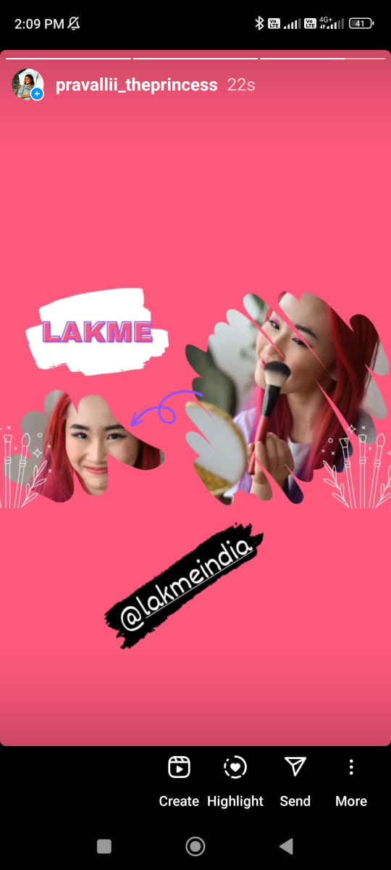
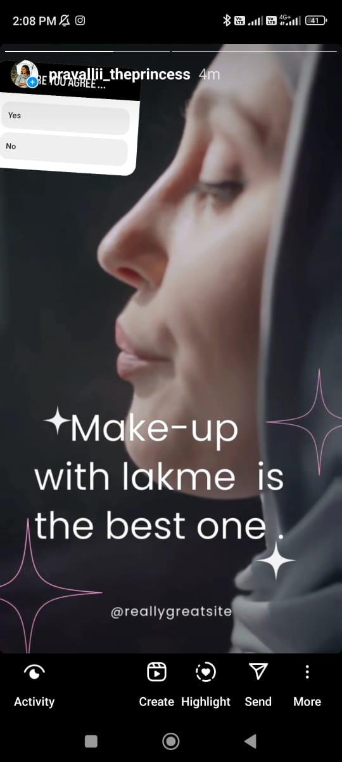
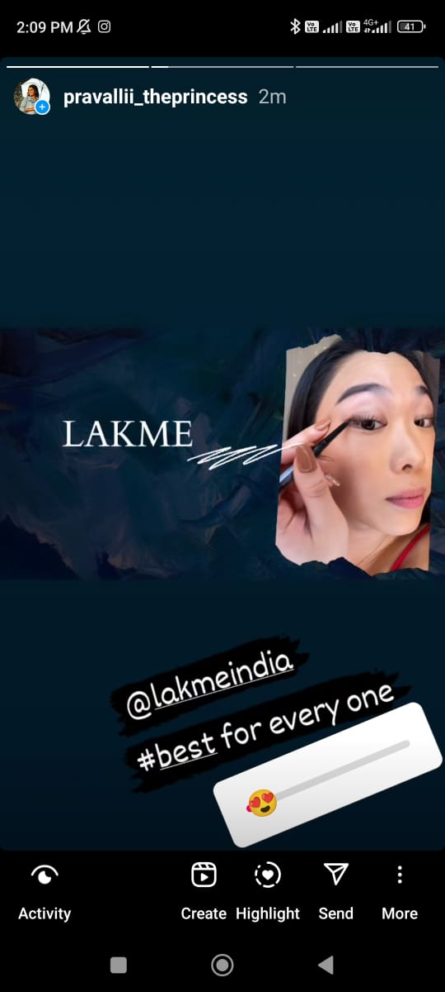

Slide 30
Presenting Lakme's New Assortment: "Dynamic and Strong"
Designs / Video Editing
Release your inward brilliance with Lakme’s most recent cosmetics assortment, intended to enable and move trust in each lady. Embrace the excellence of clear tones and intense proclamations, as we take you on an excursion to find your actual quintessence.
l AK
E '"ii lllll

Slide 31
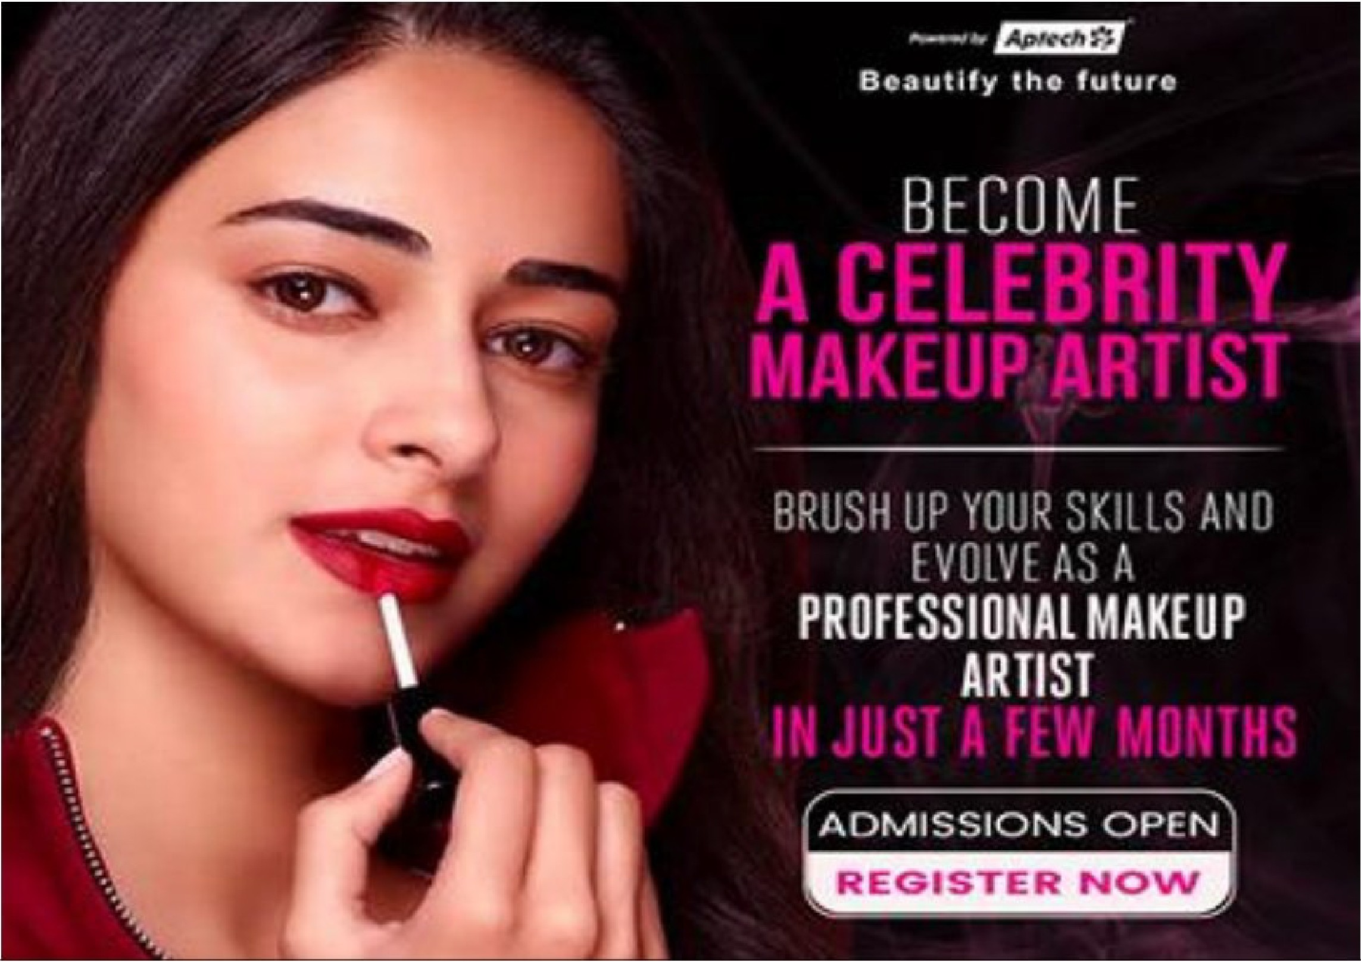
Display your Lips :
Our scope of strongly pigmented lipsticks offers the ideal equilibrium between sustenance and appeal. Find a different range of shades, going from exemplary reds to trying purples, to suit each temperament and event. Allow your lips to say a lot, leaving an enduring effect any place you go.

Slide 32
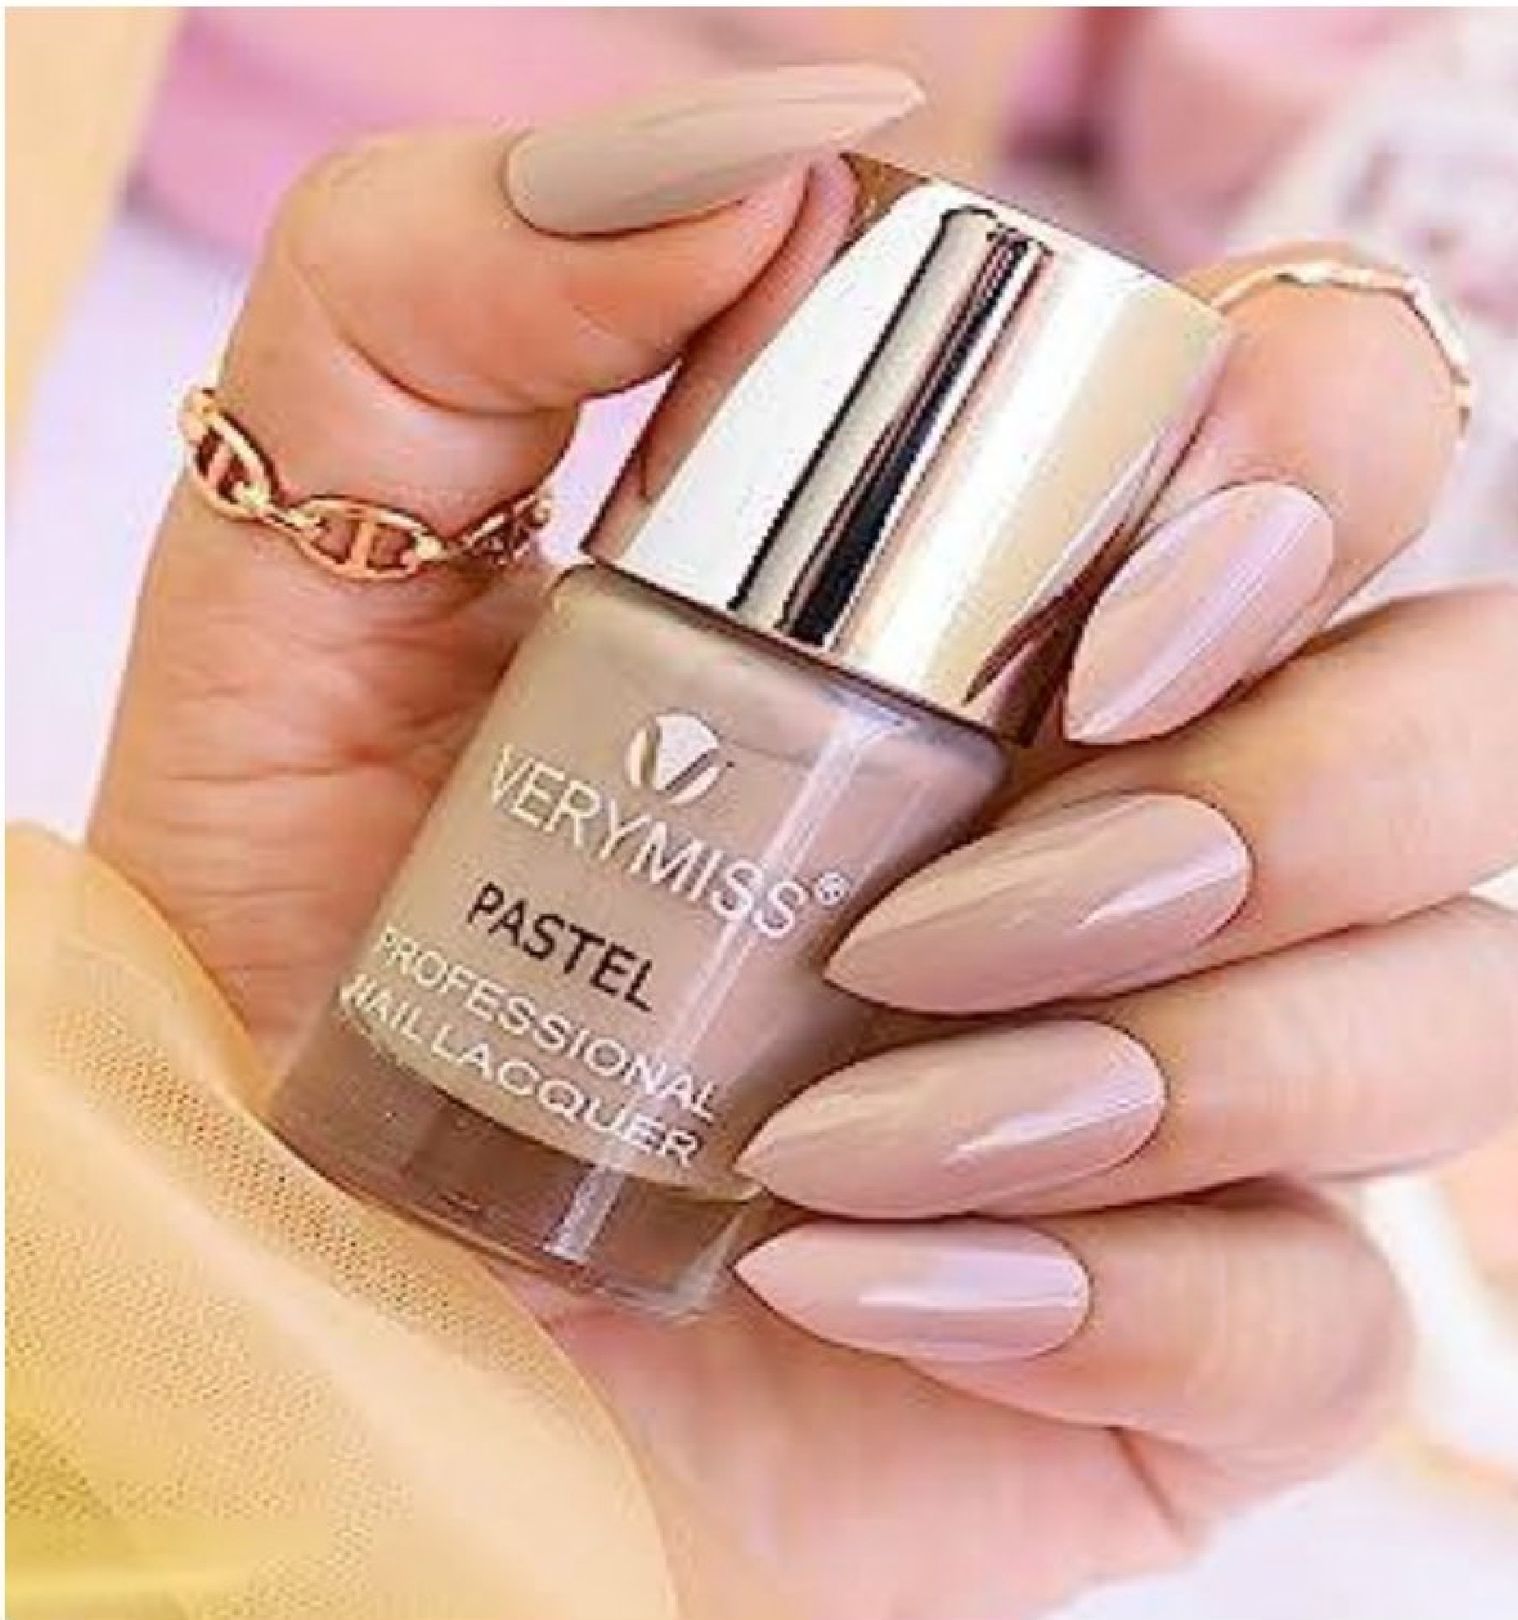
Nails Right on track:
Complete your look with our
staggering scope of nail
tones, each cautiously
organized to supplement the
assortment’s subject . Form
marvelous sparkle to rich
matte, our nail shines add
the ideal last little detail to
your group, making your
hands the focal point of
consideration.

Slide 33
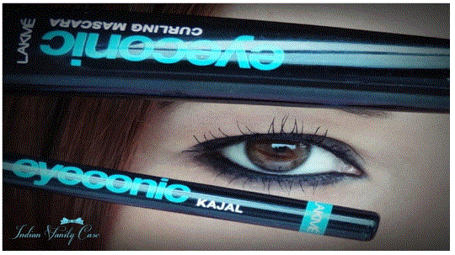
Hypnotizing Eyes:
Raise your eye game with our eye-getting eyeshadow ranges and enduring eyeliners. Whether you want a hot smokey eye or a perky pop of variety, our "Lively and Intense" assortment guarantees your eyes offer an enthralling expression each time you bat those lashes.

Slide 34
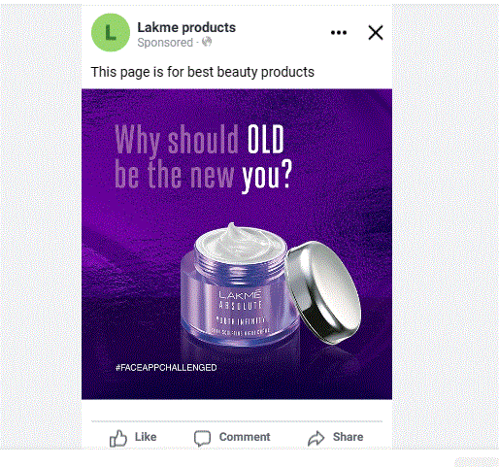
Part 4: Content Creation and Curation (Post creations, Designs/Video Editing, Ad Campaigns over Social Media and Email Ideation and Creation)
Social Media Ad Campaigns:
Ad regarding to the brand awareness of Lakme:

Slide 35
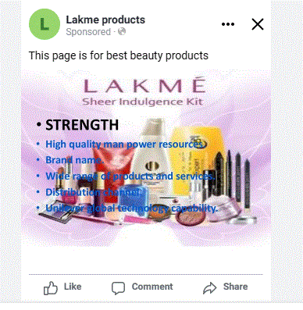
Ad Regarding to driving the Website Traffic:

Slide 36
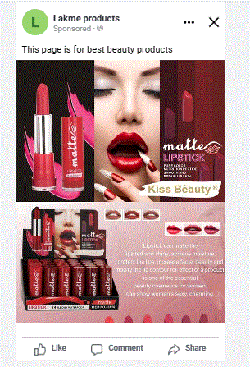
Ad to increase generate leads:

Slide 37
Advertising Goals:
Reach and Frequency: Aim to maximize the reach of advertisements to expose brand to as many potential customers as possible. Additionally, consider the frequency of your ads to ensure that your message is seen and heard repeatedly, reinforcing brand recognition.
Storytelling: Craft compelling and consistent brand stories across different advertising channels to create a lasting impression in the minds of consumers. Storytelling helps create an emotional connection with your audience and makes your brand more memorable.
Brand Identity and Messaging: Clearly define your brand's identity, values, and unique selling propositions (USPs). Ensure that your messaging consistently reflects these elements across all advertising materials to build a recognizable and coherent brand image.

Slide 38
Target Audience: Women: Lakme’s primary target audience is women of all ages. The brand offers a wide range of beauty and cosmetic products tailored to meet the needs and preferences of women. Young adults and Professionals: Lakme targets young adults, including college students and working professionals, who are interested in cosmetics and beauty products to enhance their appearance for everyday use or special occasions. Urban Dwellers: The brand has a strong presence in urban areas, where the majority of its target audience resides. Urban consumers often have greater exposure to beauty trends and are more likely to seek out cosmetic products.

Slide 39
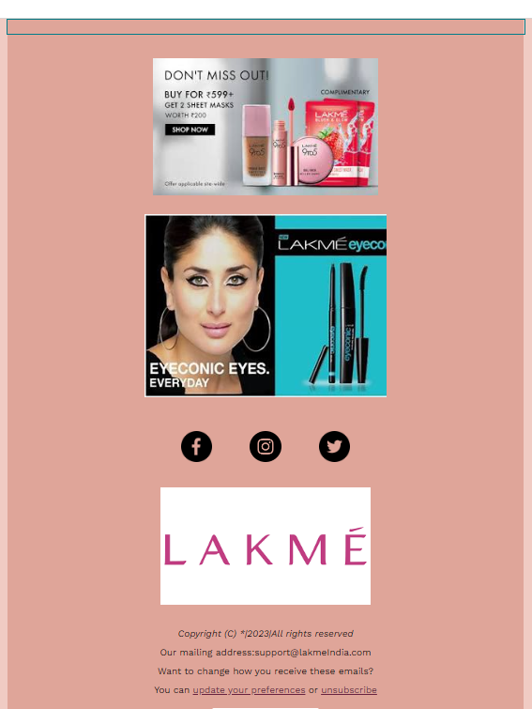
Email Ad Campaign 1 - Brand Awareness:

Slide 40
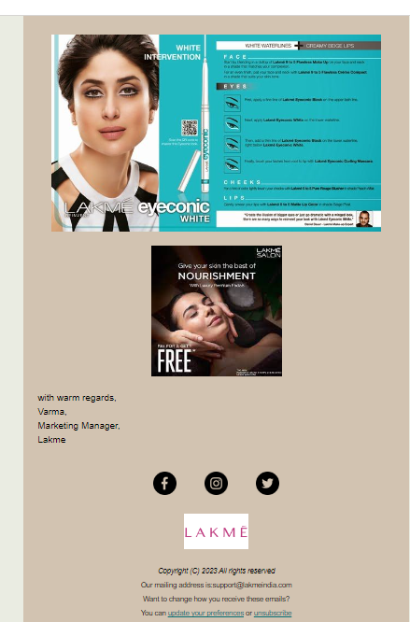
Email Ad Campaign 2 - Lead Generation:

Slide 41
Part 4: Content Creation and Curation (Post creations, Designs/Video
Editing, Ad Campaigns over Social Media and Email Ideation and Creation)
Challenges Faced :
Maintaining Originality: Creating original content can be difficult, especially when there is an abundance of existing information on the internet. Plagiarism is a serious concern and can damage the reputation of the content creator. Striking a balance between providing valuable insights and maintaining originality is a constant challenge.
Time Constraints: Content creation and curation can be time-consuming, particularly if it involves in-depth research, fact-checking, and editing. Consistently producing high-quality content within tight deadlines can be demanding.
Quality Control: Ensuring the accuracy, grammar, and overall quality of the content is vital. Content with errors or inconsistencies can harm credibility and drive away the audience.

Slide 42
Content Overload: With a vast amount of content available online, it's challenging to stand out amidst the noise. Creating something that captures the audience's attention and offers unique value becomes more difficult as the competition increases.
Audience Relevance: Understanding the target audience and tailoring content to meet their needs is crucial for success. Creating content that resonates with the intended audience requires continuous research and adaptation.

Slide 43
Copyright and legal issues: When curating content from various sources, it's essential to respect copyright laws and obtain necessary permissions. Failure to do so can lead to legal complications and reputational damage.
Finding reliable sources: Curating content involves gathering information from various sources. Verifying the credibility and reliability of these sources is critical to ensure the content's accuracy and integrity.
Keeping up with trends: Online trends and interests can change rapidly. Content creators and curators need to stay up-to-date with the latest developments to remain relevant and engaging.

Slide 44
Content distribution: Even with excellent content, reaching the target audience can be challenging. Understanding various distribution channels, search engine optimization (SEO), and social media strategies is necessary to maximize content visibility.
Measuring performance: Assessing the success of content creation and curation efforts requires tracking and analyzing relevant metrics. determining which metrics to focus on and how to improve based on the data can be a complex task

Slide 45
Dealing with negative feedback: Content creators may face criticism and negative feedback. managing this feedback constructively and learning from it without being disheartened is essential for growth.
Balancing quantity and quality: Striving to produce a high volume of content may lead to a compromise on quality. Finding the right balance between quantity and quality is a constant challenge. Overcoming these challenges requires adaptability, continuous learning, and a strong focus on the needs and preferences of the target audience. it's crucial to stay creative, receptive to feedback, and committed to refining content creation and curation processes over time.

Slide 46
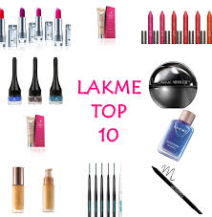
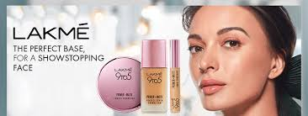
https://www.instagram.com/reel/Csn_kgAouHE/?igshid=NTc4MTIwNjQ2YQ==
https://www.instagram.com/tv/CFjOuDgBRix/?igshid=NTc4MTIwNjQ2YQ==

Slide 47
THE END

